Slide 1
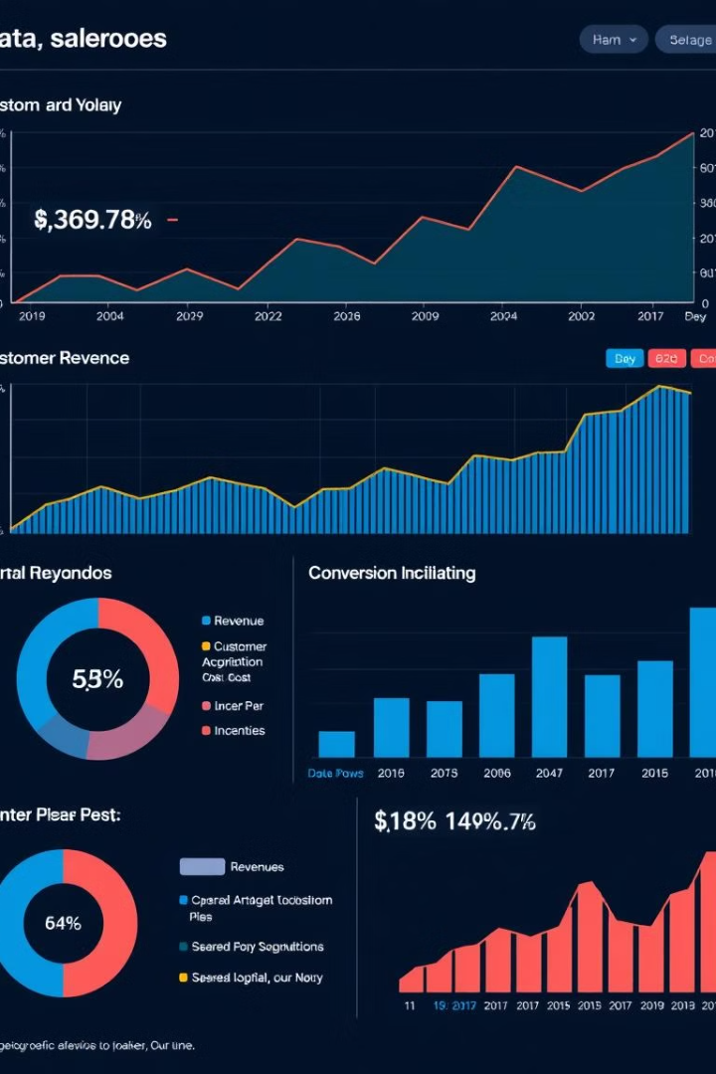

Unlocking the Power of Data Science
Welcome to a 5-day workshop designed to equip you with the foundational skills needed to navigate the dynamic world of data science. We'll explore its applications and delve into the practical aspects of data analysis.
by Faiza Ali

Slide 2
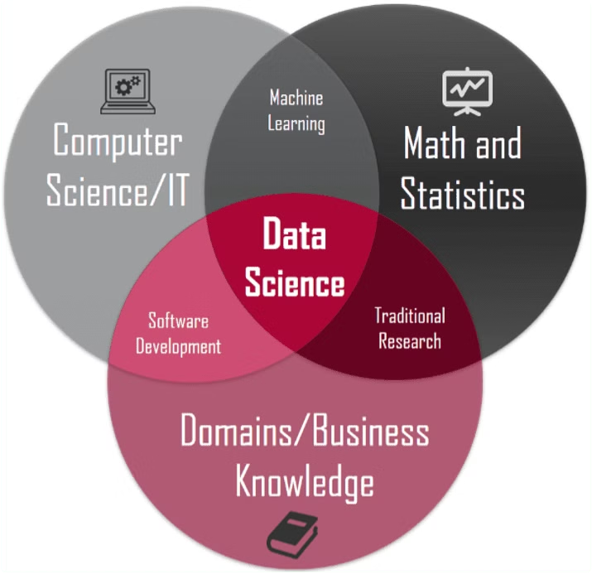
Introduction to Data Science and AI
What is Data Science?
AI and its Applications
Data science is the practice of extracting knowledge from data using scientific methods, algorithms, processes, and systems.
Artificial intelligence (AI) is a branch of computer science that focuses on creating intelligent agents that can reason, learn, and act autonomously.

Slide 3



Unveiling the Differences: AI, ML, and Data Science
Artificial Intelligence
1
The broader umbrella term for systems capable of intelligent behavior.
Machine Learning
2
A subset of AI that focuses on enabling systems to learn from data.
Data Science
3
The broader field encompassing data collection, analysis, and interpretation.

Slide 4

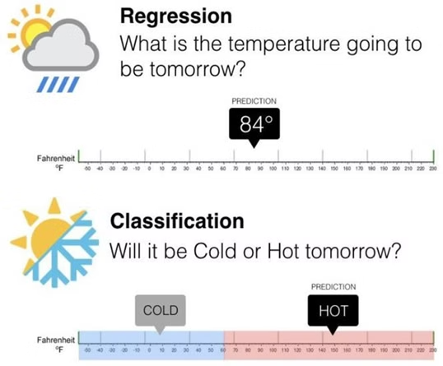
Applications of Data Science in Our Daily Lives
1
1. Personalized Recommendations
2
2. Fraud Detection
Financial institutions use data science to identify fraudulent transactions and protect customers from financial losses.
Data science powers recommendation engines that suggest products, movies, and music based on your preferences.
3
3. Maps and GPS
4
4. Medical Diagnosis
Google Maps and Waze analyze traffic patterns and provide real-time directions and estimated arrival times
Data science aids in medical diagnosis by analyzing medical images and patient data, leading to more accurate diagnoses.

Slide 5




Data Sources: Kaggle, UCI, IEEE
Kaggle
A platform for data science competitions and resources, offering a wide array of datasets.
UCI Machine Learning Repository
A well-curated collection of datasets used for research and educational purposes.
IEEE DataPort
A repository hosted by the Institute of Electrical and Electronics Engineers, providing a diverse range of data.

Slide 6
Implementing Data Science: Where and How
Industry Applications
1
Data science finds wide-ranging applications across industries such as healthcare, finance, and retail.
Business Intelligence
2
Data science helps businesses understand their customers, analyze market trends, and make informed decisions.
Research and Development
3
Data science is crucial for research and development, enabling scientists and engineers to analyze complex data.
Personal Growth
4
Data science skills are valuable for personal growth, enhancing decision-making and problem-solving abilities.

Slide 7
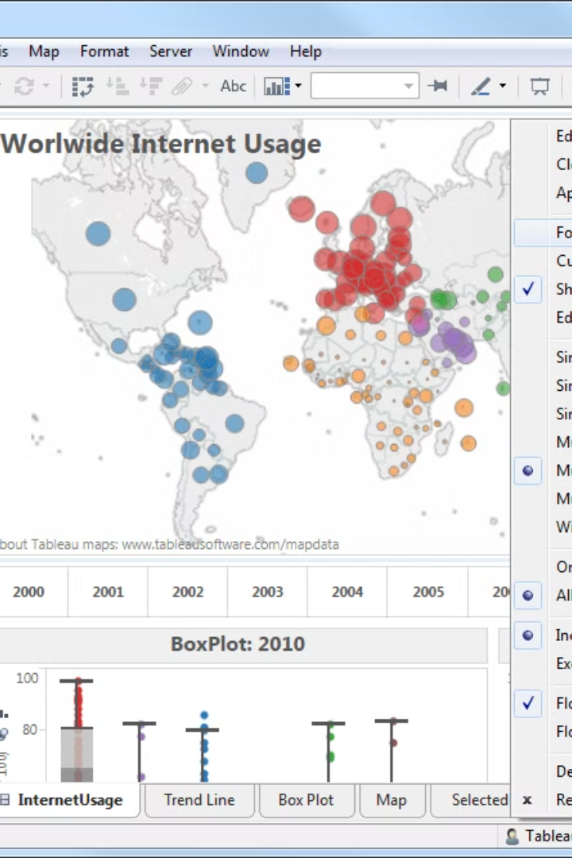
Resources for Your Data Science Journey
Colab
Tableau
A cloud-based Jupyter notebook environment for running Python code and exploring data.
A powerful data visualization tool for creating interactive dashboards and reports.
Weka
Jenni AI
A collection of machine learning algorithms for data analysis and prediction, providing a user-friendly interface.
The AI-powered workspace to help you read, write, and organize research with ease.

Slide 8

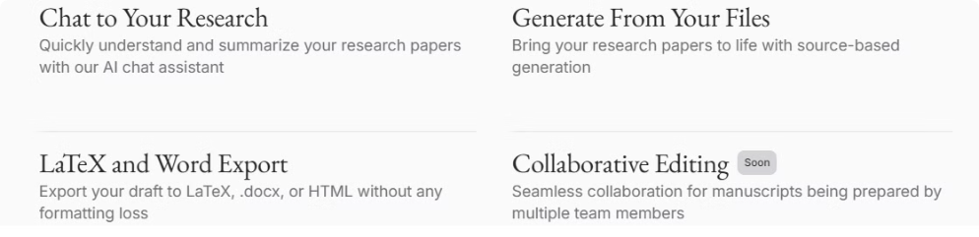
Creating Accounts for Your Data Science Toolkit
1
2
Colab
Tableau Public
Sign up for a free Google account if you don't have one already.
Create a free account to access Tableau's public data visualization platform.
3
4
Roboflow
Jenni AI
Signup for image data processing tasks for free.
Sign up for a free Jenni AI account to The AI-powered workspace to help you read, write, and organize research with ease.

Slide 9



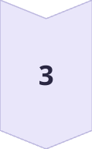
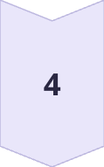
First Steps in Python: "Hello, World!"
1. Access Colab
Open a new Colab notebook and create a code cell.
2. Write Your Code
Type the following code into the cell: `print("Hello, World!")`
3. Run Your Code
Run the code cell by pressing Shift + Enter.
4. See the Output
The output "Hello, World!" will be displayed below the code cell.

Slide 10
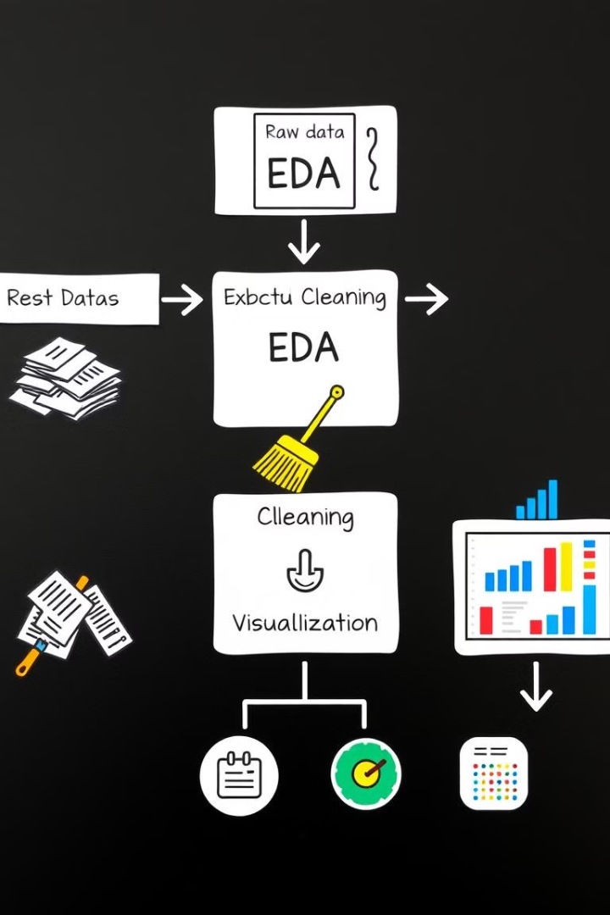
Next Steps and Conclusion
Now that you've learned the basics, focus on mastering data cleaning techniques. This includes handling missing values, removing outliers, and transforming data for analysis. Then, delve into data visualization to effectively communicate your findings through charts, graphs, and other visual aids. Remember, strong data cleaning and compelling visualizations are key to impactful research.

